Slide 1
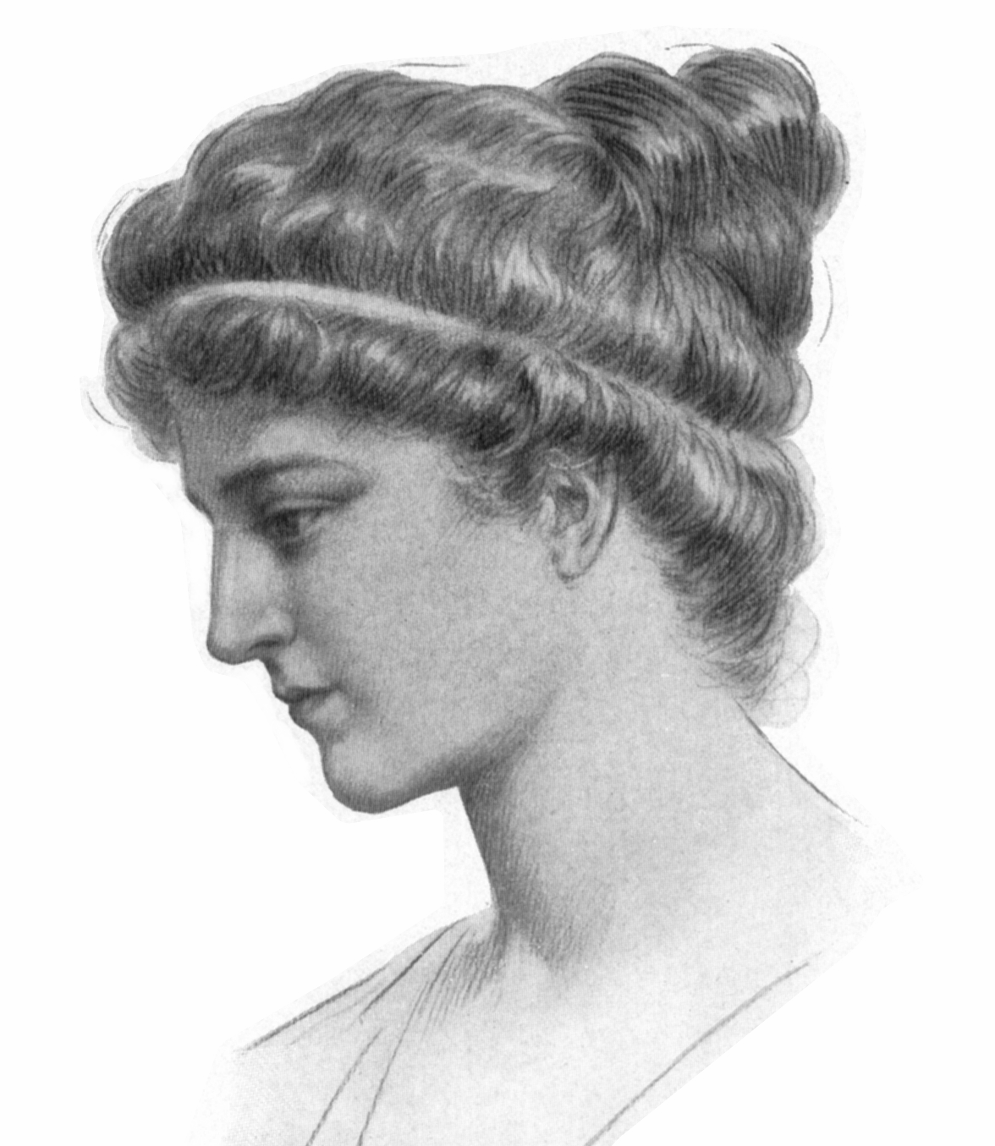
Hypatia

Slide 2
Can you find The Plough and Cassiopeia?
Constellations
Slide 1

Slide 3
Can you find The Plough and Cassiopeia?
Constellations
Slide 2

Slide 4
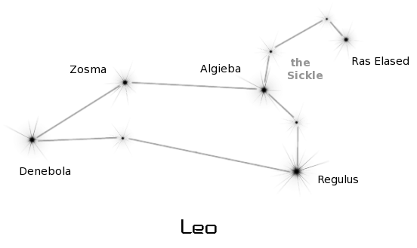
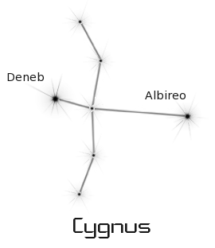
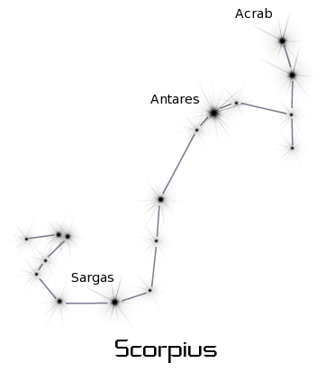
Can you find these constellations?
Slide 3

Slide 5
Can you find these constellations?
Slide 4

Slide 6
Photo credits: Drawing of Hypatia – Wikipedia – public domain Constellations – clipart-library.com (personal use)
© HMDT Music 2020

